Slide 1


AI & Data Science Track : Microsoft Data Engineer Presented BY : Mayan Mohamed Mohamed Kamel Mohamed Yamany Yassen Ehab
Customer Feedback Analysis And Improvement

Slide 2
Problem Description:
Companies often struggle to efficiently gather, process, and act upon customer feedback.
This leads to missed opportunities for improvement, customer dissatisfaction, and a lack of actionable insights.
A customer feedback analysis and improvement system that collects feedback, analyzes sentiment, and provides data-driven recommendations for improving products and services.
The system leverages a data warehouse to store feedback and performs automated sentiment analysis to categorize and prioritize actions based on customer opinions.
Proposed Solution:
Value Proposition:
The project stands out by going beyond simple feedback collection by providing actionable insights that directly inform business decisions.
Custom dashboards allow businesses to visualize customer sentiment trends and track improvement over time.

Slide 3
Tools And Technologies
Microsoft SQL Server
SQL Server Integration Services (SISS)
Microsoft Azure
Power BI
Programming Languages
Python
SQL

Slide 4
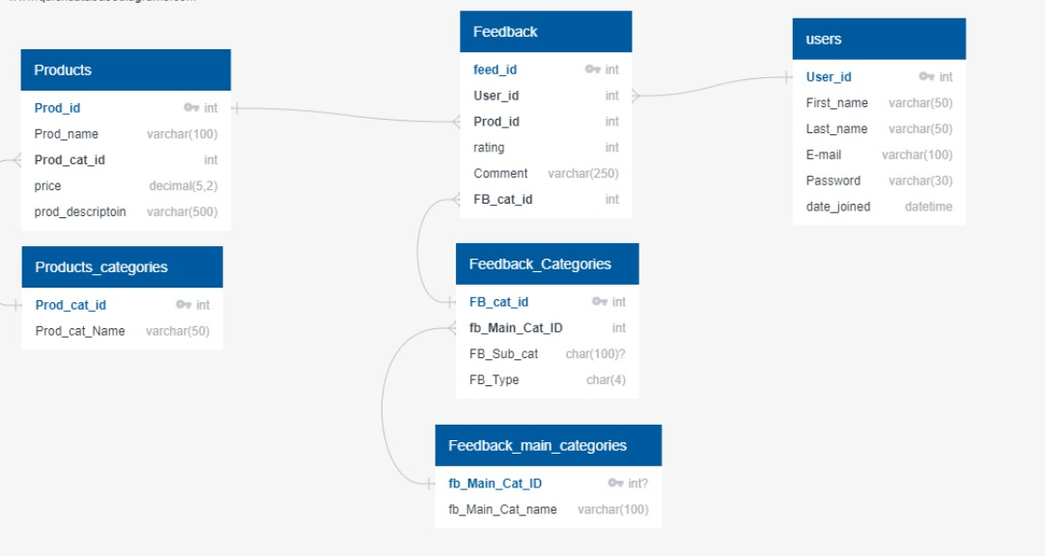
Data Structure

Slide 5
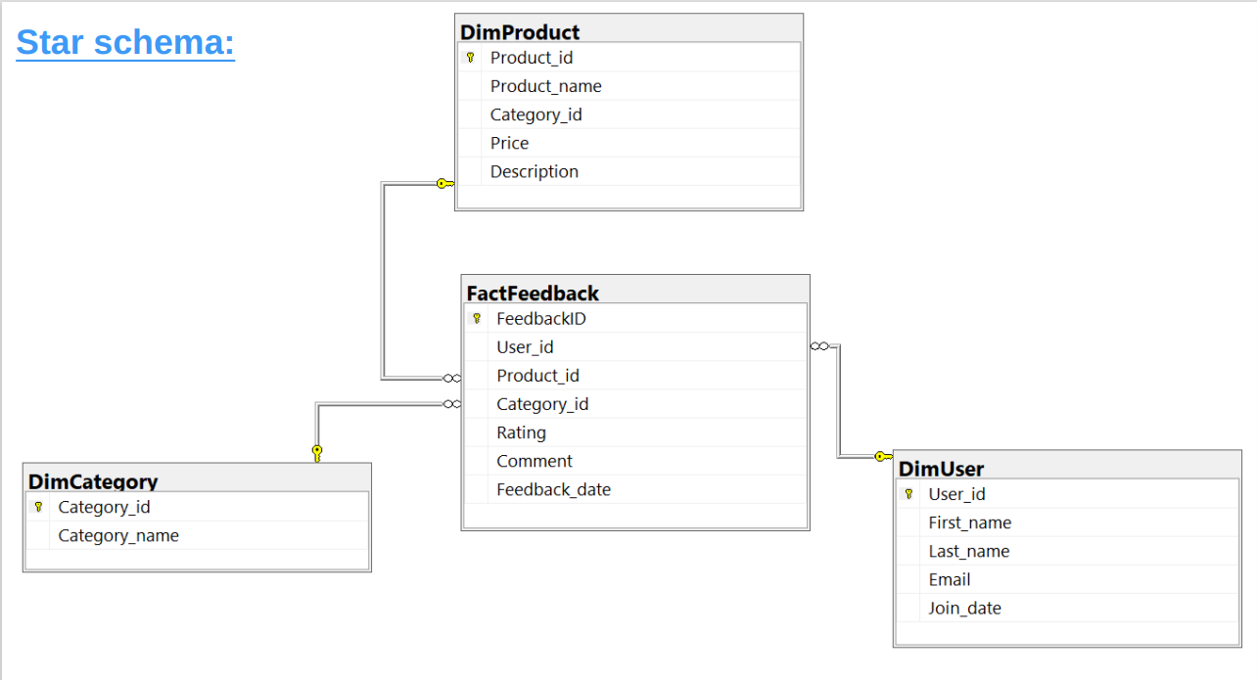
Documentation

Slide 6
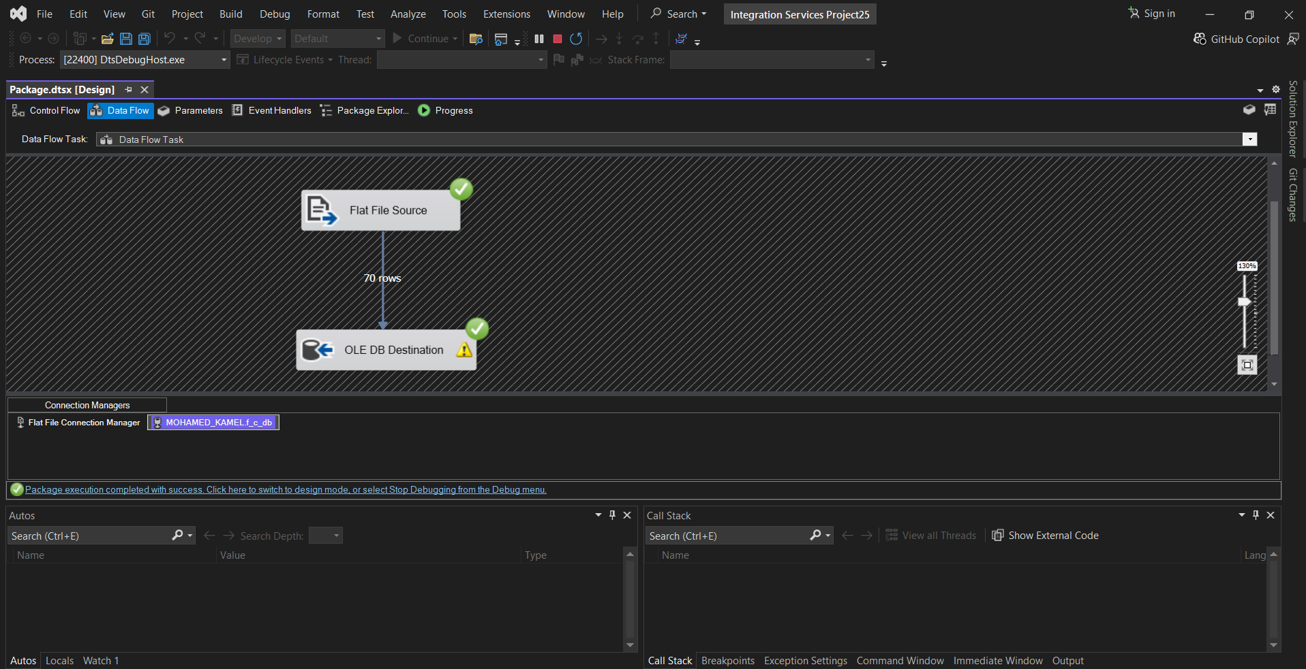
Importing historical customer feedback data from a flat file into a SQL server database using SISS

Slide 7
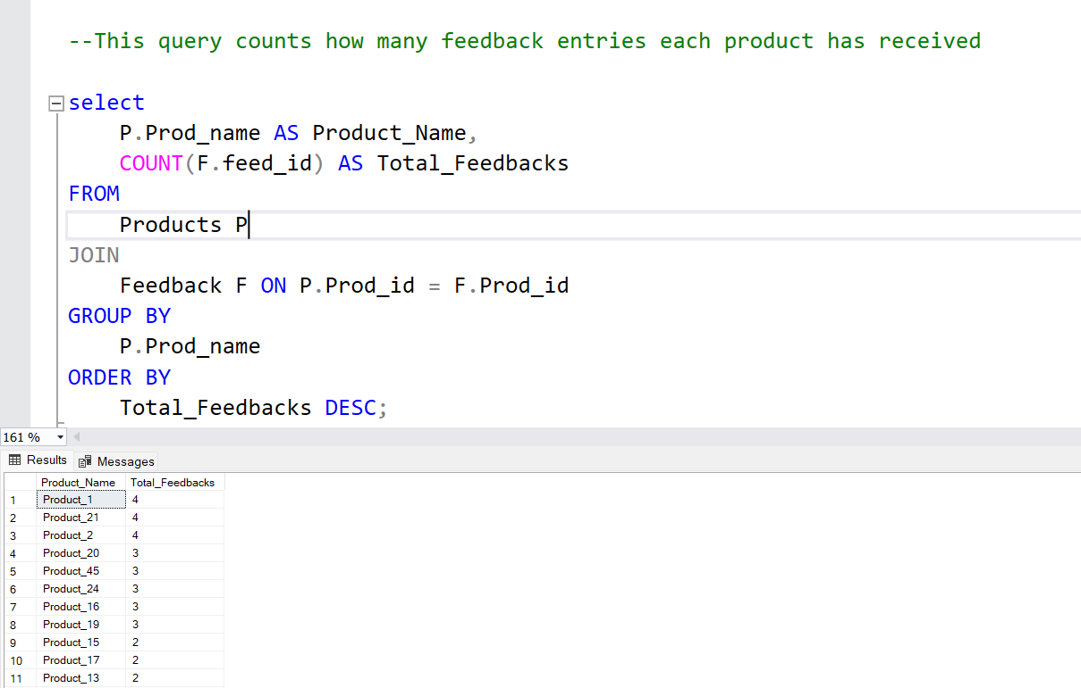
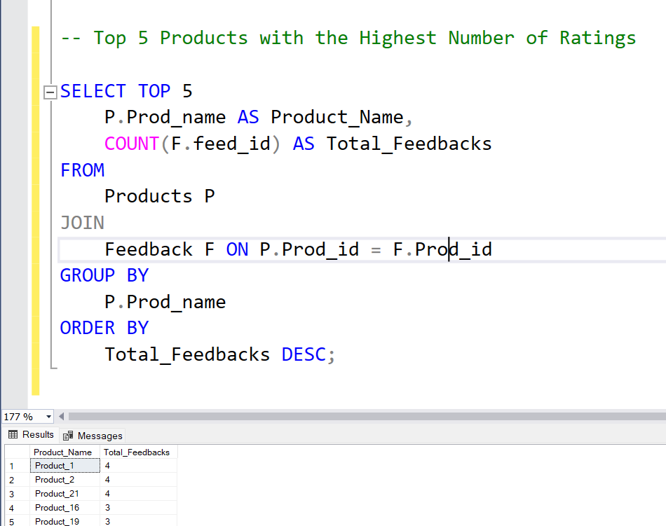
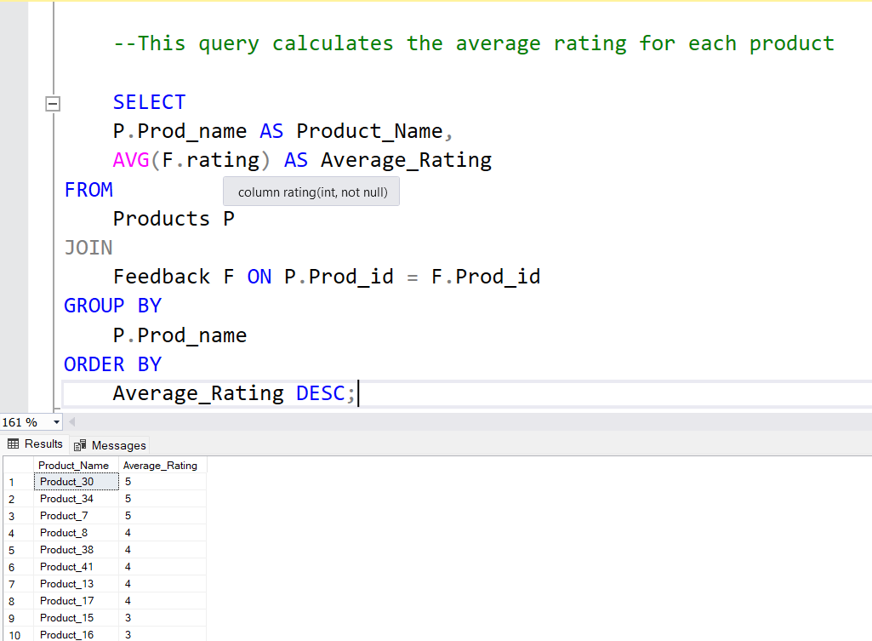
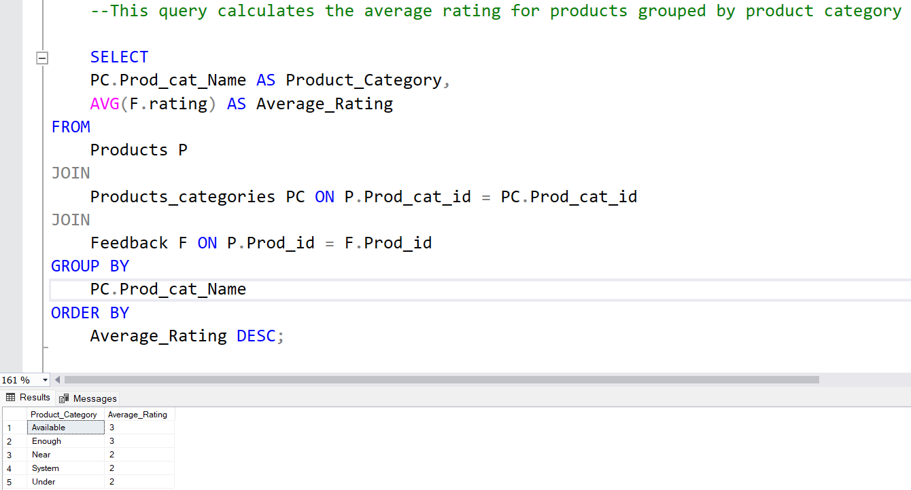
Test Queries:

Slide 8
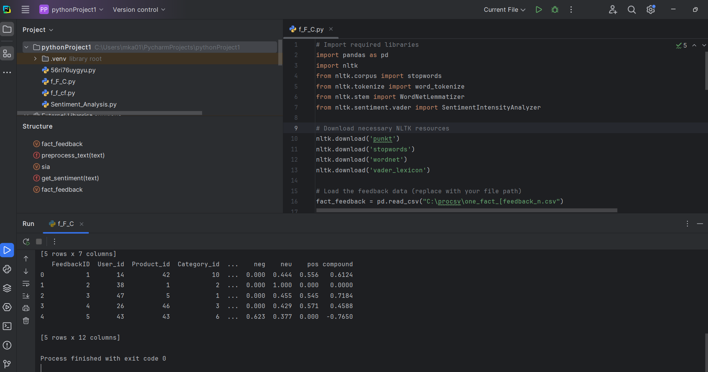
Python Processing :

Slide 9
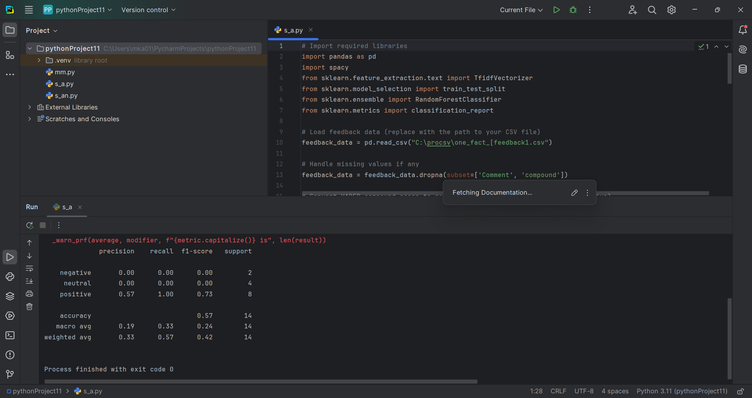
Sentiment Analysis:

Slide 10
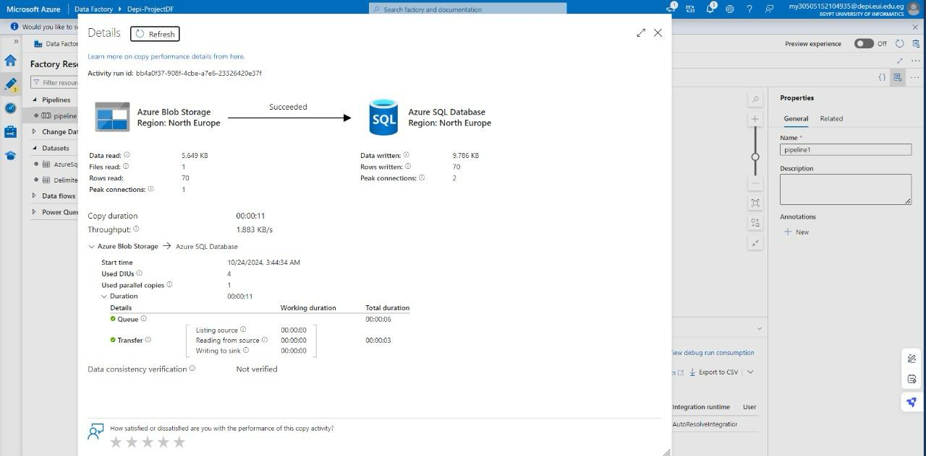
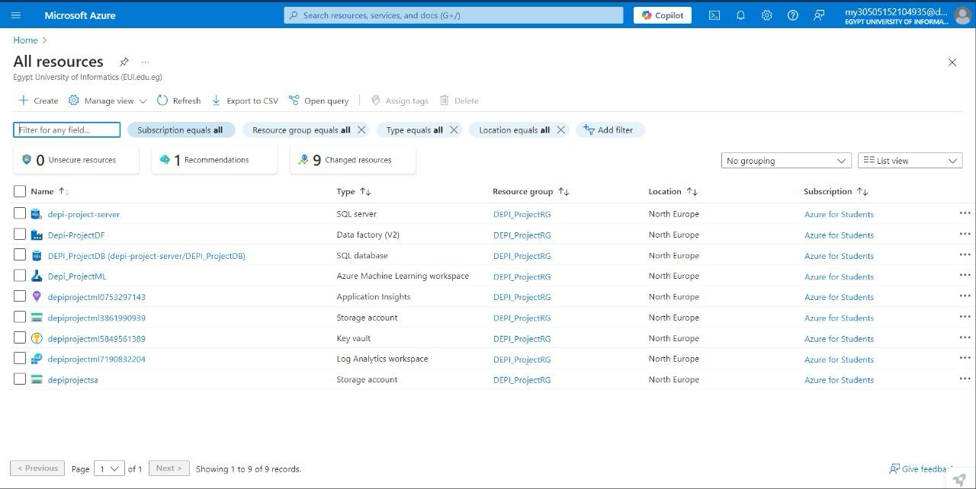
Azure Integration

Slide 11
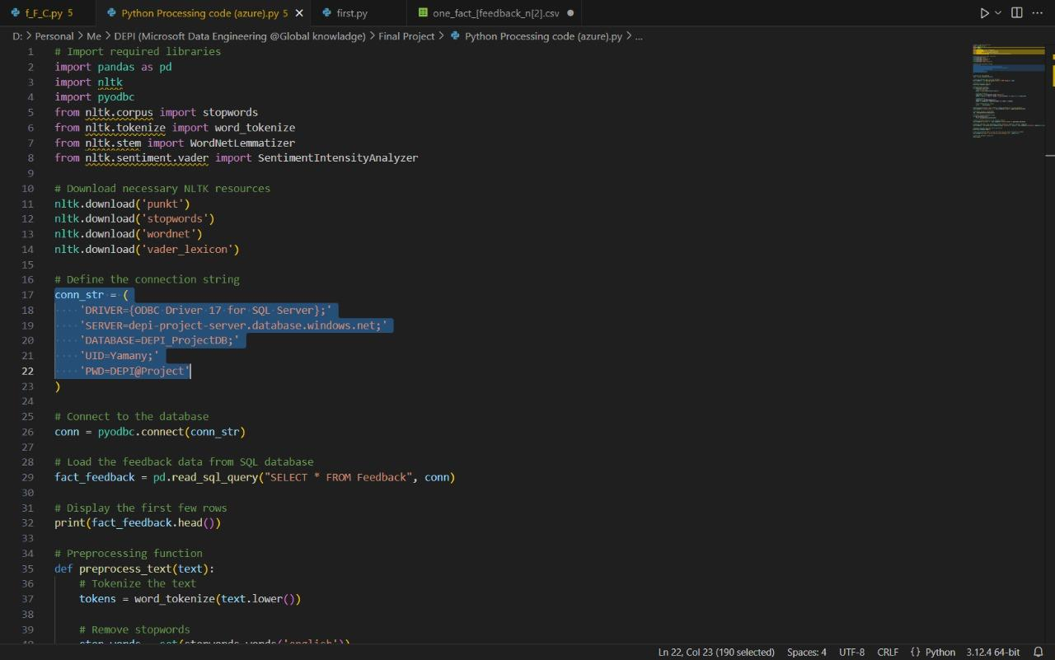
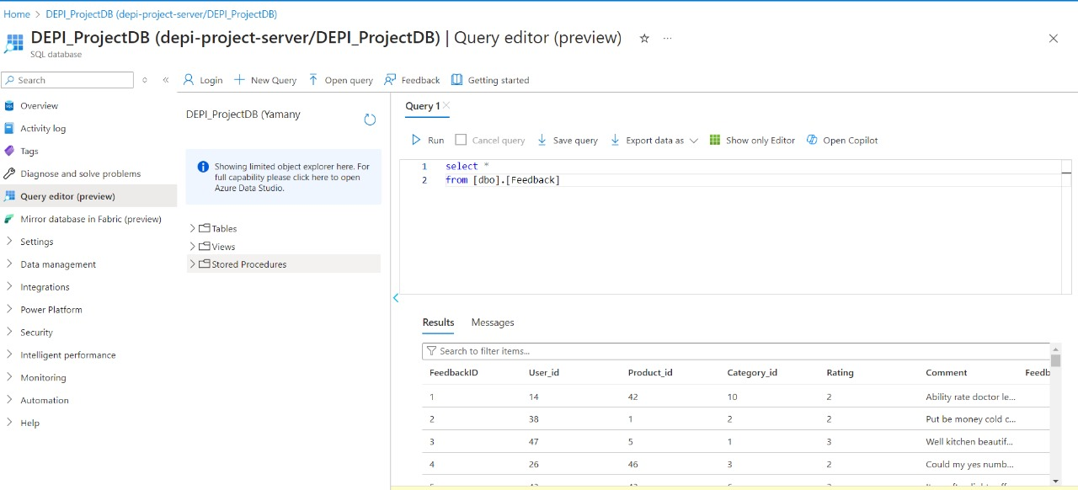

Slide 12
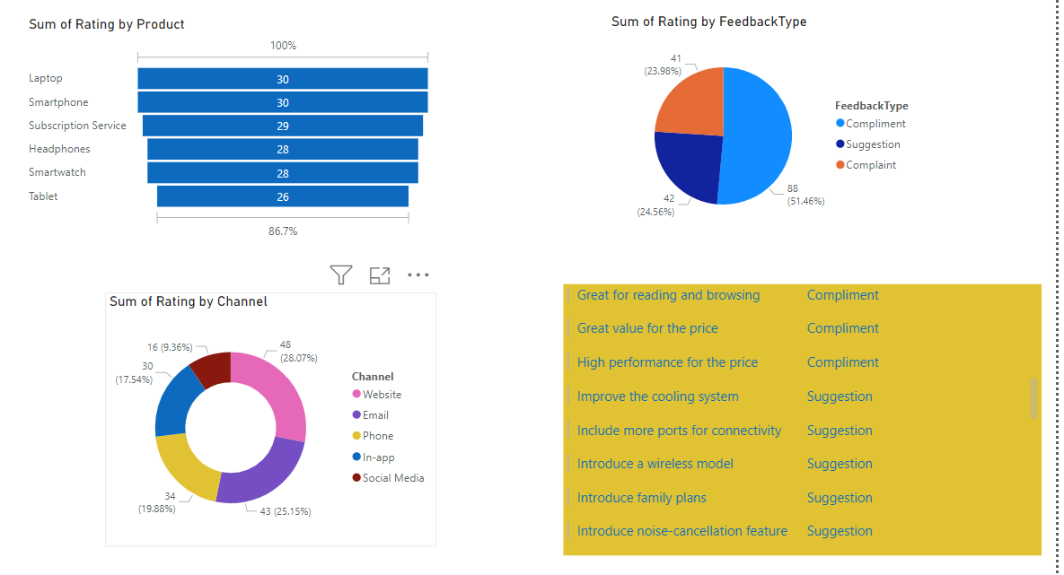
Deployment : Dashboard

Slide 13
Youssef Darwish
Project Team & Roles :
Mohamed Kamel :Data Collection , SQL Queries, ,Python Processing, Sentiment Analysis
Mayan Mohamed: SQL Database Design, Data Warehouse, Data Integration, Final Report & Presentation
Mohamed Yamany : ERD , Azure Integration
Yassen Ehab : Deployment ( Power Bi )

Slide 14
Thank You
Q & A

